Slide 1
Signatory Commitments for 2021

Slide 2
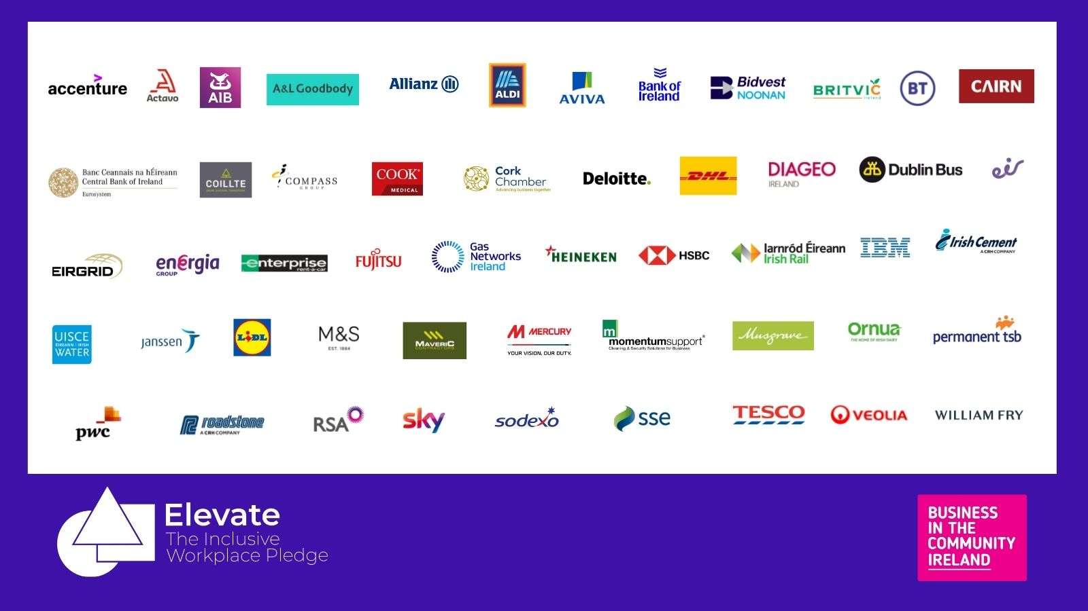

Slide 3
Commitments for 2021-22
 | Increase the number of diverse candidates presenting for interviews resulting in greater opportunities for underrepresented groups in our firm
 | Offer a range of internship and apprenticeship programmes to attract and support diverse talent
 | To offer guaranteed interviews to candidates from underrepresented groups that meet the relevant requirements for the role
 | Conduct an employee D&I survey to gather demographic data on our staff makeup as well as their thoughts on AIB as an inclusive place to work
 | Conduct an employee survey on perceptions of inclusion within the workplace
 | Enhance I&D in our policies and processes
 | Increasing disclosure of our employee D&I data, enabling us to better focus our D&I strategy & activity in a way that matters to our people and our business
 | Establish a baseline to understand ethnic and cultural minority representation across the group by the end of 2021
 | Implement processes in place to capture ED&I data, where applicable
 | Create two placements for employees of diverse ability in partnership with KARE
 | Advance our early careers attraction, development and retention programme
 | Create a Diversity & Inclusion Forum – a space for all employees to share their views and thoughts on the workplace, and influence procedures and policies relating to ED&I
 | Develop and implement a gender identity and expression in the workplace policy, toolkit and supports. Publish and promote the new policy internally and externally

Slide 4
Commitments for 2021-22
 | Development of a Diversity and Inclusion policy and strategy
 | Develop a pathways to employment programme to attract entry level staff facing barriers to employment
 | Update our recruitment content to reinforce that we are an inclusive employer and do not discriminate candidates on the basis of their background, beliefs or personal circumstances
 | Ringfence at least one student placement to someone from a diverse group/background
 | Launch an Inclusion Passport
 | DHL Supply Chain commit to the completion of DHL Certified Inclusive Leadership Program (Bronze) for all Senior Managers in our business by the end of 2021
 | Attraction and sourcing strategies to identify the best, diverse talent pool available, identify and remove all barriers to access, with diverse interview panels and candidate shortlists.
 | Increase the number of female drivers in our organisation.
 | Publication of a gender pay gap report in 2022, publicising the efforts made to close the gap
 | Conduct an employee survey on nurturing a culture of inclusion
 | Establish Female Networks across Energia Group
 | A key initiative for Enterprise is to increase our recruitment of female talent while also increasing representation of females at management levels across the organisation

Slide 5
Commitments for 2021-22
 | Identifying, understanding and improving our diversity data collection practices to develop a more diverse and inclusive workforce
 | Development of a publicly available Inclusion Statement
 | Develop a 3 year roadmap for HEINEKEN Ireland's Diversity and Inclusion strategy
 | Undertake Thematic review on Culture based on CBI Thematic review of relevant financial industry
 | External provider to work with our staff trainers on new EDI training module
 | Introduce “Skills First”, an alternative talent pipeline to include Apprenticeships, Trainees and Neurodiverse talent
 | Enhance female representation in the Graduate Programme
 | Establishment of an Ethnic & Cultural Network under the iBelong Umbrella of the Diversity & Inclusion Council to promote and celebrate racial, ethnic and cultural diversity
 | Roll out Disability Confidence Training
 | Implement appropriate mandatory diversity and unconscious bias training for all involved in recruiting and selecting and for all managers
 | Create a work placement programme for people in direct provision
 | Increase the number of female employees in the organisation

Slide 6
Commitments for 2021-22
 | Delivery of Equality, Diversity and Inclusion Workplace training to the Management and Office Support Team
 | Raise awareness of unconscious bias and its impact on decision making through training of People Managers and colleagues
 | Conduct a survey of our colleagues on their perceptions of Diversity and Inclusion within PTSB.
 | Evolve our data driven approach to improve the lived experience of all our people to create a truly inclusive workforce.
 | Partner with Local Employment Group (South Dublin Partnership) to increase candidate pool for open roles
 | Commence an internship programme to support people with intellectual disabilities to access work placements
 | Make Sky’s workforce more representative of our customers and local communities, at all levels, with a focus on gender and ethnic balance
 | To promote retention from an inclusivity perspective, we are launching a ‘spotlight on’ campaign to raise awareness of our personnel who are from diverse cultures, heritage and ethnic backgrounds, particularly those who have progressed and developed internally within the business
 | We will ensure that all Hiring Managers complete an inclusive recruitment upskilling programme to understand how to be consciously inclusive
 | All our colleagues will complete mandatory Diversity and Inclusion training
 | Review job descriptions and current recruitment channels
 | Partner with local DEIS schools and rural schools to introduce the world of law to TY students

