Slide 1
Manage & Showcase Your Employee Volunteering
www.thrive-csr.com

Slide 2
The Context…
Well managed Employee Volunteering programmes can contribute significantly to Employee Engagement.
The Challenges…
Managing volunteer sign-ups; accurately tracking and reporting on participation; and understanding the difference your volunteering has made is inherently difficult and time consuming.
The Opportunity…
Adopting specialist software will not only streamline the management and reporting of volunteering but will enable feedback on your community impact to be effortlessly collected from volunteers and NGOS…. helping to enhance your volunteer programme and boost Employee Engagement.

Slide 3
Thrive CSR…
Thrive CSR is specialist Volunteering Management & CSR Software
…which is straightforward and intuitive for users
…is focused around the needs of CSR managers
…and is built to scale with you as your requirements grow

Slide 4
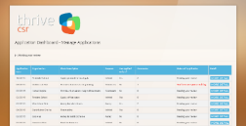
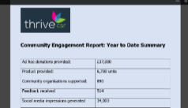
Thrive CSR’s Employee Volunteering Module Benefits …
Streamline sign-ups and volunteer management for ALL volunteering types; from one-off team building activities, to long term mentoring.
Handle everything is one central system and avoid significant admin.
Gather feedback on participation and community impact with ZERO time input by using our auto-feedback technology.
Easily showcase your program and its impact to internal and external stakeholders with tailored reports and real-time reporting .

Slide 5
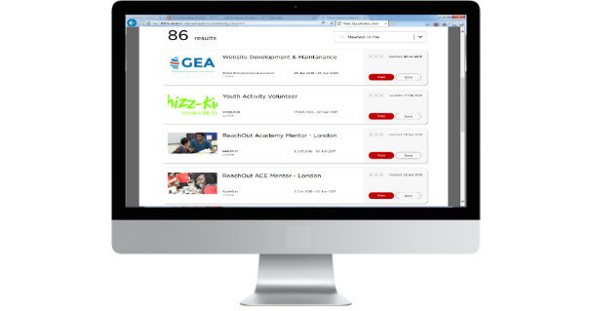
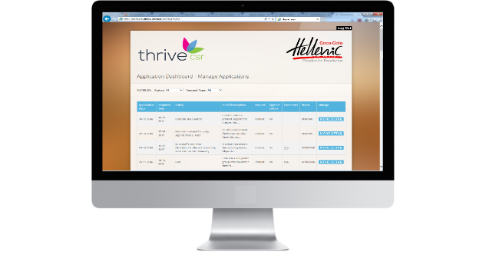
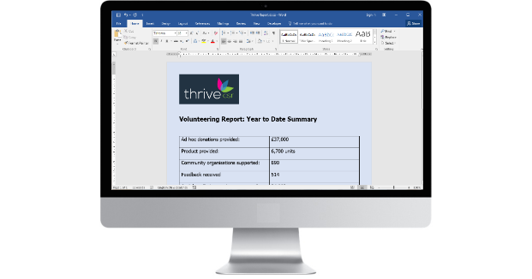
Volunteering Module Overview ….
Automatically collect feedback from Employees
Manage all stages of volunteering,
from a central dashboard
Real time, detailed reports on activity
and community impact
Collate, curate and communicate
engaging volunteer opportunities on a branded ‘Volunteering Portal’
Note – diagram depicts basic system. Many additional features and functionality are available to add as your needs grow
For example, employee profiles, accepting volunteering suggestions from charities/community groups or employees and many more.

Slide 6
Other modules available from Thrive CSR….
Matched Funding/Fundraising
Environmental/Sustainability Data Collection
Grants / Donations Management
General CSR Module for central management of a broad range of initiatives
Contact Details...
Neil Macdonald
Chief Executive Officer
Thrive-CSR
E: neilm@thrive-csr.com
T: +44 7789644049
Dr Nick Murry
Head of CR & Client Services
Thrive-CSR
E: nickm@thrive-csr.com

