Slide 1
The Leaders’ Group on Sustainability Communications & Public Affairs 22nd February 2018

Slide 2
Who are we
The Leader’s Group on Sustainability
A coalition of leading companies in Ireland working together to take action on key sustainability challenges
Europe’s first multi-sectoral group of companies collaborating for action
Notes:
On carbon-europe first

Slide 3
Why its so timely
In terms of the business world, trust in CEOs as a voice of authority increased by 14 points to 41 per cent
It also finds that businesses are now expected to be “an agent of change” with 63 per cent of respondents calling on CEOs to “take the lead” on change rather than wait for government to impose it
If businesses in Ireland want to earn the trust of the public, they need to identify an area of social responsibility where they have the authority and credentials to be an effective voice, and then share their story in a way that is authentic and powerful.
Edelman Trust Barometer
Notes:
The public cares, investors care and your employees care

Slide 4
BlackRock CEO Larry Fink
Companies must ask themselves: What role do we play in the community? How are we managing our impact on the environment? Are we working to create a diverse workforce?
Today, our clients — who are your company's owners — are asking you to demonstrate the leadership and clarity that will drive not only their own investment returns, but also the prosperity and security of their fellow citizens
Notes:
Image on larry

Slide 5
The Harvard Business Review

Slide 6
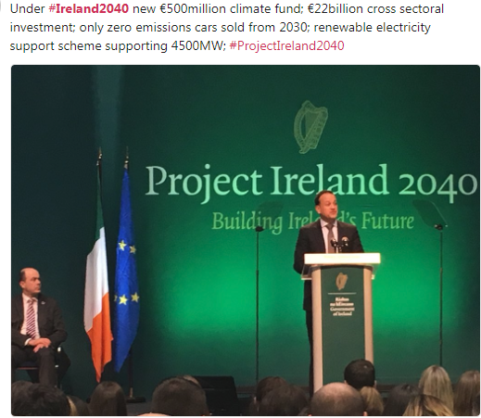
Ireland 2040
Notes:
Government cares

Slide 7
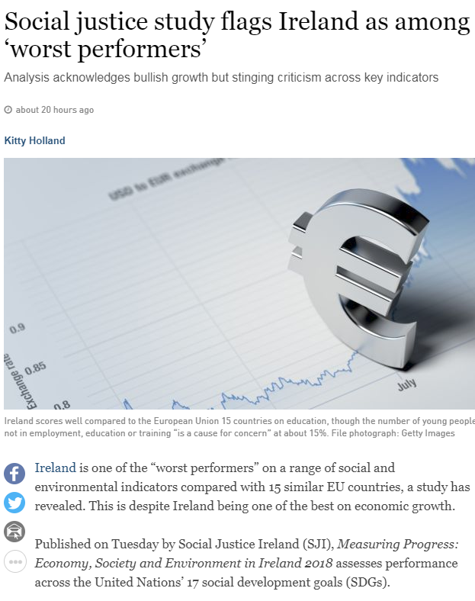
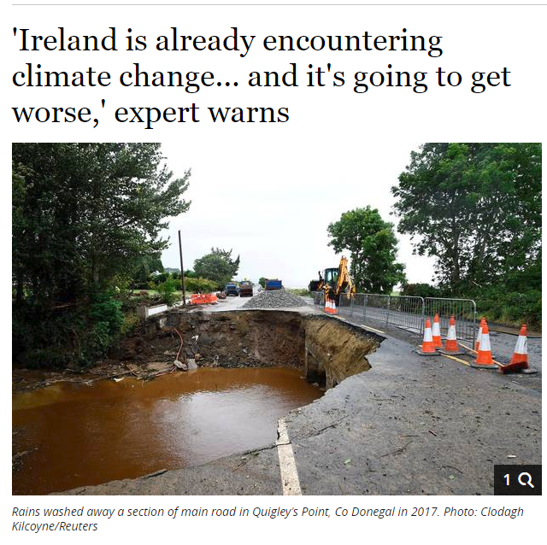

Slide 8
Our communication objectives
Launch The Leaders’ Group on Sustainability-first action-the Pledge
Create awareness of the members (companies and CEOs) of the Group to key audiences
Position the Group as the ‘go-to’ collective when it comes to creating innovative solutions to sustainability challenges
Make linkages between Brand Ireland to the Group’s activities
Inspire other companies to join the Group
Encourage other companies to engage with outcomes of the Group
Connect the dots between the Group and the Mark

Slide 9
2018 Communications Timeline
May 17th 2018 – Launch of the Leaders’ Group –Transition to the low carbon economy (low carbon challenge)/underpinned by B2B platform)
Q3 –Social Cohesion: Publish Leaders’ Position Paper with statement of intent on collective action
Q3/4- Worker of the Future: Publish Leaders’ Position Paper with statement of intent on collective action
Q4 – Publish end of year statement at the BITCI CEO Forum
Notes:
Help each other to reduce their carbon emissions

Slide 10
Our key audiences
The Media: Irish and International
Top 1000 companies in Ireland
The Group’s Employees (over 30,000)
The Group’s Customers & other Stakeholders
Irish Government
State agencies e.g. IDA
International sustainability organisations-leverage WBCSD
Civil society organisations
Sceptics
Notes:
IDA right place right time. Wouldn’t it be great to have sustainability on their facts sheet in 2019

Slide 11
Our key messages
CEO-led Group
The Group is the engine-room for change
This is about transformational change
From talking to action
It’s about collaboration
This is a National group
Mark-to action-to Mark development
All contributing to Brand Ireland
Notes:
CEO plus the company

Slide 12
Examples of Tools and Tactics
Audience | Activity | Activity | Activity
Media | Press launch/Group photo/meetings with key business editors/media partner | Media toolkit for each CEO/spokesperson re key messages/3 sub group chairs/Leverage partners | Ongoing op-ed opportunities throughout the year-e.g. Earth Hour
Business | Direct Mail-jointly signed letter to Top 1000/Call to Action | Video of all CEOs/Storyteller in chief/infographics/co-ordinated digital media campaign | Identify speaking opportunities at large business events
Employees | Each CEO communicates to all their employees on launch day | Develop social media toolkit for employees to engage and become ambassadors for the Group | Membership of the Group is embedded into company presentations etc.
Notes:
80% of millennials want to use a corporate hashtag to share their stories
highlight

Slide 13
Audience | Activity | Activity | Activity
Customers/Stakeholders | Each CEO communicates to their stakeholders on launch day/Global HQs/industry bodies | Promote involvement throughout the year e.g. customer magazines, in-store (if relevant) | Supply chain and community communications
Government | Launch with An Taoiseach/Relevant Ministers Group Delegation | Info session on the Group in the Dáil | Local government outreach
State Agencies | Invite key agencies such as IDA to press conference | Delegation meeting with state agencies | Communications toolkit for agencies such as IDA and EI
International | Speak at WBCSD conference | Showcase at CSR Europe | Delegation to Davos
Civil Society/Sceptics | Out reach to key NGOs e.g. Friends of the Earth | Video from NGOs about the Group | Consultations
Notes:
Don’t highlight international

Slide 14
The fundamentals
Public relations plan
Messaging/FAQ toolkit for all companies
Digital media roll out
Key milestones for the year
Co-ordinated look and feel to the Group

Slide 15
Measurement
Evaluate PR reach
Awareness amongst Top 1000 companies
Measure knowledge amongst Employees
Target for incoming queries about joining the Group
Government reach

Slide 16
Key challenges
One centralised approach with activities cascaded amongst the Group
Consistent messaging
Episodic v campaign?
Resources

Slide 17
Path to Launch
Agreement on the communications & public affairs strategy
Alignment of messages
Commitment on resources

